Slide 1

AWS CLOUDTRAIL:
Monitoring and Governance
Neha N K - 23MCAR0020
Anushree Joshi - 23MCAR0005
Meghana Kolipaka - 23MCAR0016
Niladri Paul - 23MCAR0021

Slide 2
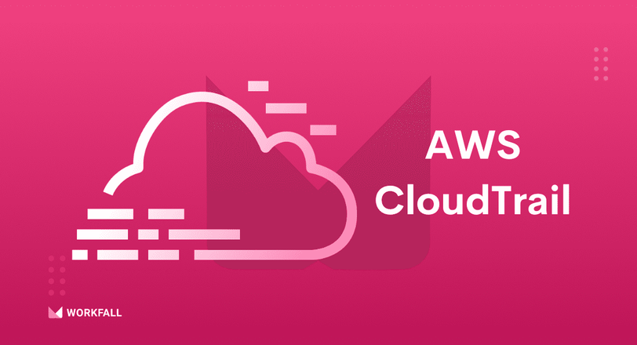
WHAT IS AWS CLOUDTRAIL?
1
AWS CloudTrail is a service that enables governance, compliance, and operational auditing for your AWS account.
2
Purpose:
Log, continuously monitor, and retain account activity across your AWS infrastructure.
3
Key Functionality:
Tracks all actions taken via the AWS Management Console, SDKs, command-line tools, and other AWS services.

Slide 3

KEY FEATURES
Event Logging:
Data Integrity:
Captures AWS API calls and service events.
Ensures that the recorded logs are tamper-proof.
Multi-Region Support:
Integration with CloudWatch:
Covers operations across all regions.
Enables real-time activity monitoring and alarms.

Slide 4
WHY USE CLOUDTRAIL?
1. Security and Compliance:
Helps meet regulatory requirements by maintaining a history of API calls.
Ensures transparency in user activities.
2. Troubleshooting:
Diagnoses operational issues by tracing back the actions taken.
3. Monitoring:
Detects suspicious activities or unauthorized access attempts.
4. Auditing:
Provides detailed logs for audits and reviews.

Slide 5
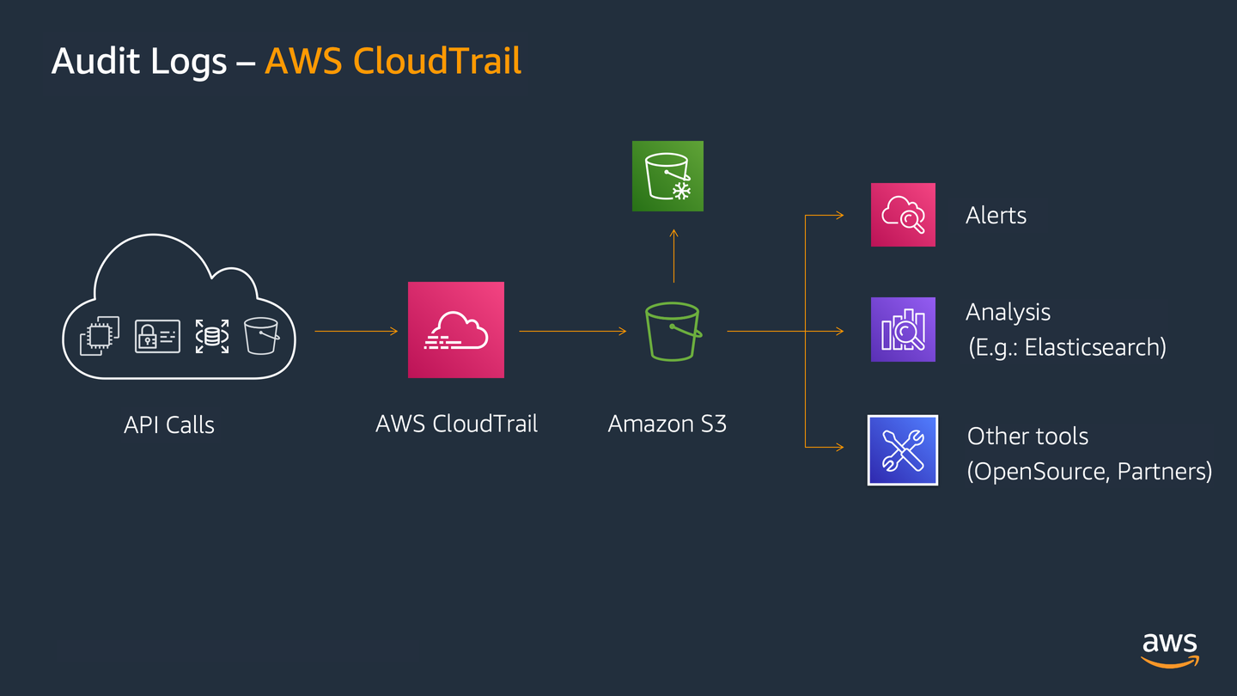
HOW CLOUDTRAIL WORKS
1. Action is Performed:
A user or service makes an API call (e.g., launching an EC2 instance).
2. CloudTrail Captures Event:
The API call is logged as an event.
3. Event Storage:
Logs are stored securely in an S3 bucket.
4. Real-Time Monitoring (Optional):
Events can be sent to CloudWatch Logs for immediate insights.

Slide 6
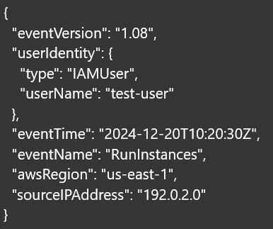
EXAMPLE EVENT LOG (JSON):

Slide 7
CORE COMPONENTS
Event:
S3 Bucket
A record of an AWS API call or service action.
Stores CloudTrail log files.
Trail:
CloudWatch Logs:
A configuration that enables logging for an account.
Offers real-time monitoring and alerts.

Slide 8
CLOUDTRAIL PRICING
Paid Features:
Free Tier:
Data Events Logging: Tracks S3 object and Lambda function calls.
CloudTrail Insights: Detects anomalies in account activity.
Cost depends on the volume of events logged.
Management event logging.
Retains logs for the last 90 days.

Slide 9
CLOUDTRAIL USE CASES
1. Security:
Detect unauthorized access or misuse of resources.
2. Compliance:
Maintain an auditable record of actions for regulations like GDPR and HIPAA.
3. Debugging:
Pinpoint the source of failures or unexpected behavior in applications.

